Slide 1

Visión por Computador
Domingo Mery
Departamento de Ciencia de la Computación
Escuela de Ingeniería
Universidad Católica de Chile
Federated / Swarm Learning

Slide 2
Motivación
Existen dos Centros Médicos A y B
Ambos tienen datos (ejemplo imágenes) con información sensible (nombres, RUT, dirección, etc.)
Se desea entrenar un modelo con los datos de los dos Centros
Cómo compartir datos entre dos Centros Médicos manteniendo la privacidad de los datos?

Slide 3
PASO 0
ANONIMIZACiÓN:
Eliminar todo dato como RUT, nombre, etc. que pueda ser usado para indentificar al paciente.
A veces se puede compartir una imagen ya que la imagen sola no sirve para identificar a la persona.

Slide 4
MACHINE LEARNING
DATABASE
CNN
Accuracy

Slide 5
SEPARATED LEARNING
DATABASE A
DATABASE B
DATABASE C
CNN
CNN
CNN
Accuracy-A
Accuracy-B
Accuracy-C

Slide 6
FULL LEARNING (training)
DATABASE A+B+C
CNN
Accuracy-F

Slide 7
FULL LEARNING (testing)
DATABASE A+B+C
DATABASE A
DATABASE B
DATABASE C
CNN
CNN
CNN
CNN
(trained)
(trained)
(trained)
(trained)
Accuracy-F
Accuracy-A
Accuracy-B
Accuracy-C

Slide 8
FEDERATED LEARNING
DATABASE A
DATABASE B
DATABASE C
CNN
CNN
CNN
weights
weights
weights
Server Central
Accuracy-F

Slide 9
SWARM LEARNING (training)
DATABASE A
DATABASE B
DATABASE C
CNN
weights
CNN
weights
CNN
weights

Slide 10
SWARM LEARNING (training)
DATABASE A
DATABASE B
DATABASE C
CNN
CNN
CNN

Slide 11
SWARM LEARNING (testing)
DATABASE A
DATABASE B
DATABASE C
CNN
CNN
CNN
(trained)
(trained)
(trained)
Accuracy-A*
Accuracy-B*
Accuracy-C*

Slide 12
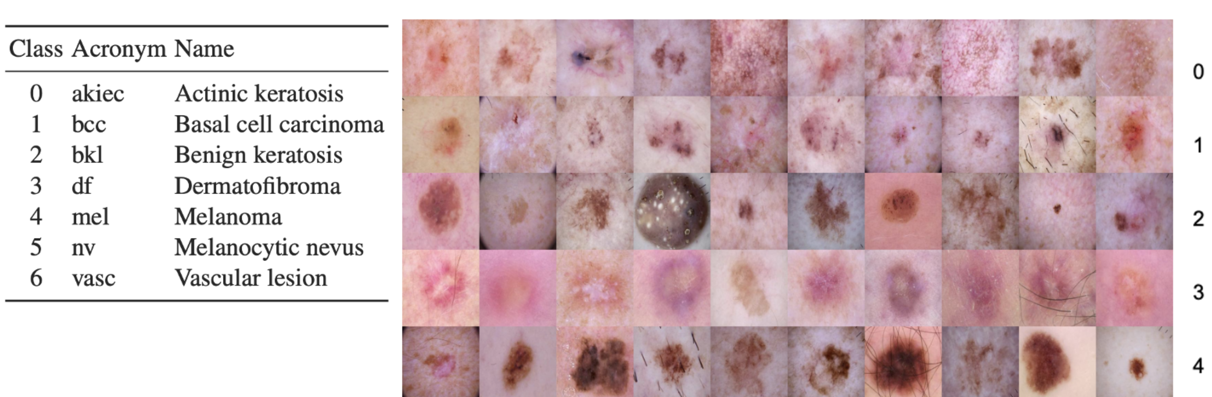
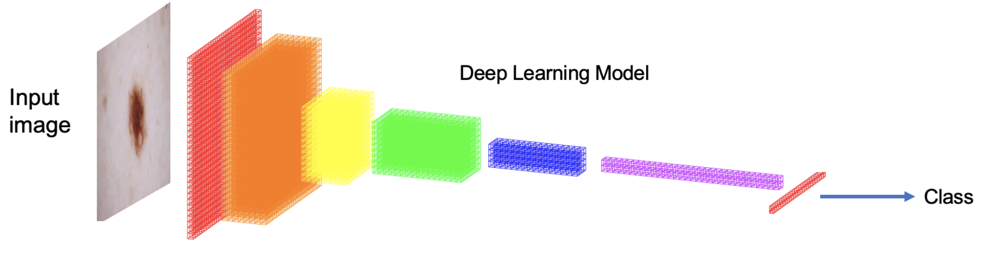
EXPERIMENTS
Skin Lesion Recognition
Datasets
ISIC (International)
AR (Argentina)
CL (Chile)
5250 samples / dataset
1050 samples / class

Slide 13
RESULTS
TESTING WITH
 | Full | ISIC | AR | CL
Full
ISIC
AR
CL
Swarm
TRAINING WITH

Slide 14
RESULTS
TESTING WITH
 | Full | ISIC | AR | CL
Full | 0.6469 | 0.7190 | 0.6905 | 0.5952
ISIC
AR
CL
Swarm
TRAINING WITH

Slide 15
RESULTS
TESTING WITH
 | Full | ISIC | AR | CL
Full | 0.6469 | 0.7190 | 0.6905 | 0.5952
ISIC |  | 0.6810
AR |  |  | 0.7619
CL |  |  |  | 0.4429
Swarm
TRAINING WITH

Slide 16
RESULTS
TESTING WITH
 | Full | ISIC | AR | CL
Full | 0.6469 | 0.7190 | 0.6905 | 0.5952
ISIC |  | 0.6810
AR |  |  | 0.7619
CL |  |  |  | 0.4429
Swarm |  | 0.8095 | 0.8333 | 0.6762
TRAINING WITH

Slide 17
RESULTS
TESTING WITH
 | Full | ISIC | AR | CL
Full | 0.6469 | 0.7190 | 0.6905 | 0.5952
ISIC | 0.5728 | 0.6810 | 0.6048 | 0.4000
AR | 0.4810 | 0.3524 | 0.7619 | 0.3667
CL | 0.3952 | 0.4095 | 0.3619 | 0.4429
Swarm | 0.5222 | 0.8095 | 0.8333 | 0.6762
TRAINING WITH

